Slide 1




RETWEET
Data Mining Project
Alessio Schiavo
REAL TIME TWITTER SENTIMENT ANALYSIS FOR BRAND IMPROVEMENT

Slide 2



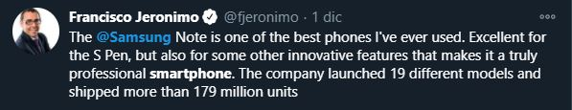


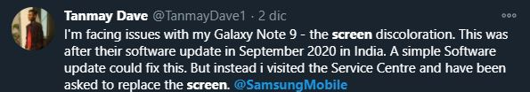
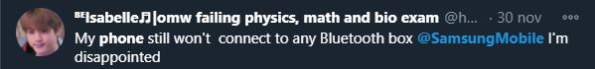
INTRODUCTION: PROJECT PURPOSE
The purpose of this project is to develop an
end-to-end real time Twitter monitoring system in order to extract useful insights related to customer’s sentiment toward the Samsung brand.
The task is challenging as tweets text content is often far from being gramatically and sintactically correct.
Can we build a machine learning based system
capable of properly classifying Samsung devices related Tweets?

Slide 3




THE SYSTEM
LISTENER
FILTER
PARSER
TEXT
ELABORATION
MODEL
MySQL DB
DASHBOARD WEB APP
.
.
.
1 Twitter users tweet something related to Samsung devices

Slide 4
THE SYSTEM
LISTENER
FILTER
PARSER
TEXT
ELABORATION
MODEL
MySQL DB
DASHBOARD WEB APP
2 The tweets are catched by the Listener Python Script (Tweepy library)

Slide 5
THE SYSTEM
LISTENER
FILTER
PARSER
TEXT ELABORATION
MODEL
MySQL DB
DASHBOARD WEB APP
3 The incoming tweets are filtered out (spam bot, keywords and blacklisting)

Slide 6
THE SYSTEM
LISTENER
FILTER
PARSER
TEXT ELABORATION
MODEL
MySQL DB
DASHBOARD WEB APP
4 The tweets are parsed by the Parser Python Script

Slide 7
THE SYSTEM
LISTENER
FILTER
PARSER
TEXT ELABORATION
MODEL
MySQL DB
DASHBOARD WEB APP
5 The tweet batch is stored within the MySQL back-end database

Slide 8
THE SYSTEM
LISTENER
FILTER
PARSER
TEXT ELABORATION
MODEL
MySQL DB
DASHBOARD WEB APP
6 Tweets posted in the last 10 minutes are retrieved from the DB and undergo the text elaboration step

Slide 9
THE SYSTEM
LISTENER
FILTER
PARSER
TEXT ELABORATION
MODEL
MySQL DB
DASHBOARD WEB APP
7 Elaborated tweets are given as input to the Machine Learning Model

Slide 10
THE SYSTEM
LISTENER
FILTER
PARSER
TEXT ELABORATION
MODEL
MySQL DB
DASHBOARD WEB APP
8 The Analytical Web Dashboard is refreshed with new data coming from newly classified tweets

Slide 11

THE PARSER MODULE
The task is challenging as tweets text content is often far from being gramatically and sintactically correct. Moreover, tweets do not contain structured text data:
URLs embedded in the actual text content
User mentions @
Frequent grammatical errors
Abbreviated forms
Numbers
Emojis
We need to clean the text from useless stuff and try to standardize tweets content as much as possible.
RAW TWEETS
PYTHON SCRIPT
PARSED TWEETS

Slide 12





THE PARSER MODULE: STEPS
URLs removal
Mentions removal
Partial grammar correction
.!?,
Punctuation signs removal
0..9
Numbers removal
Emojis removal
An effective grammar correction is very hard to achieve. In this project simple standard english grammar rules are checked, exploiting the language_check python module.

Slide 13
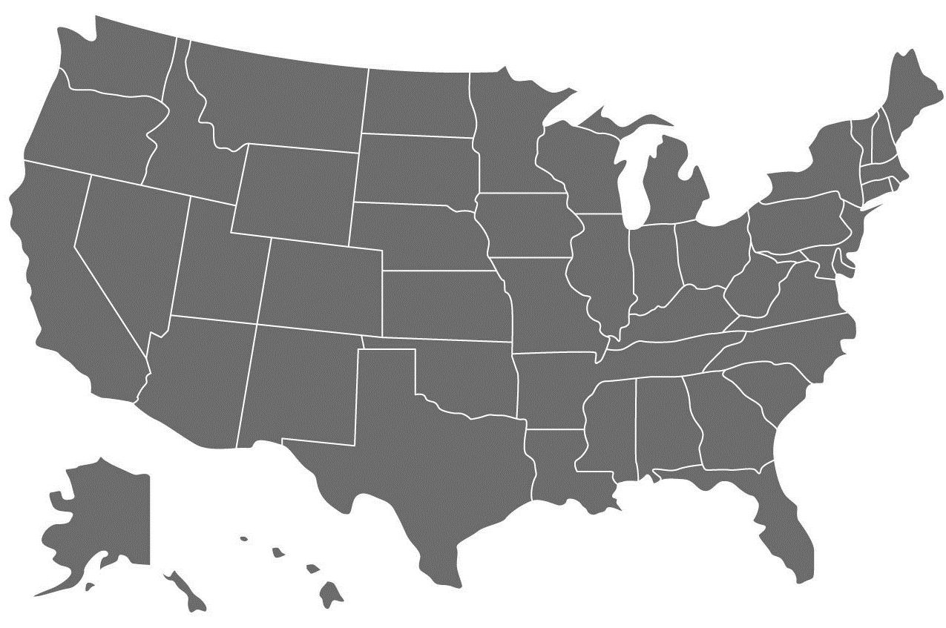
BUILDING THE DATASET: TWEETS SCRAPING
For the system to work, there’s the need to collect data as much close as possible, in content and distribution, to the data
on which the system must work with.
Due to offical Twitter APIs limitations, within a single tweets scraping session, only tweets posted no earlier than 7 days
back with respect to the scraping date, can be retrieved.
Therefore, in order to collect enough data to train our model, four weekly tweets data collection were
performed: each Monday, starting on Monday 14 September until Monday 12 October.
Tweets search query criterias adopted:
Keywords filtering
English language tweets
Tweets posted in one of the American States: more specifically, the query search was performed iteratively for each of the US States. (a search area corrispondent to each US State was defined through coordinates and a radius of 350km)

Slide 14
BUILDING THE DATASET: SCRAPE RESULTS
A total amount of 7666 tweets has been collected, as shown in the table.
WEEK | NR OF TWEETS SCRAPED | SCRAPING SESSION TIME (min)
14/09 – 21/09 | 1609 | 39
21/09 – 28/09 | 3052 | 61
28/09 – 5/09 | 1762 | 46
5/10 – 12/10 | 1543 | 45
TOTAL | 7666 | 191
The set of tweets resulting from each week of collection has been manually tagged with a sentiment class
(positive, negative or neutral) and further filtered: bot spam tweets were deleted and the relative user blacklisted.
After this step, the final dataset has been obtained, with 2329 labeled samples.

Slide 15


BUILDING THE DATASET: DATASET OBTAINED AND CLASS DISTRIBUTION
After merging together the results of the 4 week scrape the final dataset is obtained:
Positive
Negative
Neutral
Positive/Negative/Neutral
distribution
Total # of samples: 2329

Slide 16


FEATURES EXTRACTION
UNI-GRAMS COUNTING
TEXT ELABORATION
TOKENIZATION
NLTK
STOPWORDS FILTERING
POS TAGGING & LEMMATIZATION
UNI + BI-GRAMS
COUNTING
SELECT K BEST
UNI-GRAMS TF-IDF
UNI + BI-GRAMS TF-IDF
We need to mine tweets preprocessed text in order to extract useful features for models training.
Four features extraction pipelines have been tried, and each model has been trained and tuned on the output of each of these:
Pipeline 1: Tokenization, Stopwords Filtering, Lemmatization, Uni-grams Counting, Best k Features Selction
Pipeline 2: Tokenization, Stopwords Filtering, Lemmatization, Uni + Bi-grams Counting, Best k Features Selction
Pipeline 3: Tokenization, Stopwords Filtering, Lemmatization, TF-IDF of Uni-grams, Best k Features Selction
Pipeline 4: Tokenization, Stopwords Filtering, Lemmatization, TF-IDF of Uni + Bi-grams, Best k Features Selction
Input: Preprocessed Tweet Text Output: TERMS COUNT/TF-IDF sparse matrix

Slide 17
FEATURES EXTRACTION STEPS
Vocabulary size: 4688 terms
CountVectorizer:
Counting only Uni-grams or both Uni-grams and Bi-grams.
Ignoring terms having a document frequency strictly higher than the given threshold value.
Threshold values tried [0.65, 0.75, 0.85, 1.0](the parameter represents a portion of documents)
[3. TF-IDF Transformer]
4. Best k Features Selection:
Selection of the k best features based on statistical tests (chi2).
Values tried as k [1000, 2000, 2500, 3000, 3500, 3700, "all"]

Slide 18
BUILDING THE ML MODEL
Models selected for training:
Base Estimators
SVM
Logistic Regression
MN – Bayes
CN – Bayes
Decision Tree
Ensembles
DT + Bagging
SVM + Bagging
LR + Bagging
Random Forest
X | TERMS COUNTING | TF-IDF
UNI-GRAMS
UNI + BI-GRAMS
1
2
1
2
3
4
5
1
2
3
4
5
3
9
6
7
8
4
5
1
2
3
4
5
1
2
3
4
5
6
Each Base Estimator has been trained and tuned for each of the 4 combinations.
Ensembles were not trained for each combination due to large training time needed.
Total number of training and tuning pipelines: 20 base + 4 ensembles
7
8
9

Slide 19

BUILDING THE ML MODEL: BASE ESTIMATORS
In the table are reported the performances of the base classifiers in the prediction of tweets classes. The metrics taken
into consideration are accuracy, precision, recall and F1-score.
CLASSIFIER | ACCURACY |  | PRECISION |  | RECALL |  | F1-SCORE
 | MEAN | STD DEV | MEAN | STD DEV | MEAN | STD DEV | MEAN | STD DEV
SVM | 0.8037 | 0.0258 | 0.8058 | 0.0253 | 0.8054 | 0.0257 | 0.8056 | 0.0255
UNI-GRAMS TF-IDF
Logistic Regression | 0.8003 | 0.0428 | 0.8034 | 0.0421 | 0.7997 | 0.0434 | 0.8015 | 0.0428
UNI-GRAMS COUNT
MN-Bayes | 0.7526 | 0.0227 | 0.7516 | 0.0226 | 0.7598 | 0.0219 | 0.7556 | 0.0223
UNI-GRAMS COUNT
CN-Bayes | 0.7663 | 0.0249 | 0.7651 | 0.0251 | 0.7733 | 0.0252 | 0.7692 | 0.0251
UNI-GRAMS TF-IDF
C4.5 Decision Tree | 0.7397 | 0.0315 | 0.7426 | 0.0286 | 0.7385 | 0.0293 | 0.7397 | 0.0289
BI-GRAMS COUNT
Each classifier went through hyperparameters tuning using the GridSearchCV algorithm. Testing and Validation were
performed using 10 Folds Cross Validation tecnique.

Slide 20

BUILDING THE ML MODEL: SVM VS LOGREG PERFORMANCES BY CLASS
In the table are reported the performances class by class of the best and the second best performing base classifiers: SVM and LogReg. Both the algorithms perform quite well in all classes, they are slightly better in positive tweets prediction. Moreover,
in general we have the confirmation that SVM performs slightly better.
SVM | ACCURACY | PRECISION | RECALL | F1-SCORE
 | MEAN | MEAN | MEAN | MEAN
AGGREGATED | 0.8037 | 0.8018 | 0.8054 | 0.8056
NEUTRAL CLASS |  | 0.7493 | 0.7577 | 0.7535
NEGATIVE CLASS |  | 0.8156 | 0.8186 | 0.8171
POSITIVE CLASS |  | 0.8405 | 0.8293 | 0.8349
Better
Worse
LogReg | ACCURACY | PRECISION | RECALL | F1-SCORE
 | MEAN | MEAN | MEAN | MEAN
AGGREGATED | 0.8003 | 0.8028 | 0.8019 | 0.8018
NEUTRAL CLASS |  | 0.7216 | 0.8095 | 0.7630
NEGATIVE CLASS |  | 0.8399 | 0.7796 | 0.8086
POSITIVE CLASS |  | 0.8468 | 0.8159 | 0.8311
Each classifier went through hyperparameters tuning using the GridSearchCV algorithm. Testing and Validation were
performed using 10 Folds Cross Validation tecnique.

Slide 21
BUILDING THE ML MODEL: ENSEMBLES
In the table are reported the performances of the ensemble classifiers in the prediction of tweets classes. The metrics taken
into consideration are accuracy, precision, recall and F1-score.
CLASSIFIER | ACCURACY |  | PRECISION |  | RECALL |  | F1-SCORE
 | MEAN | STD DEV | MEAN | STD DEV | MEAN | STD DEV | MEAN | STD DEV
DT + Bagging | 0.7882 | 0.0224 | 0.7910 | 0.0220 | 0.7876 | 0.0226 | 0.7893 | 0.0223
UNI-GRAMS TF-IDF
SVM + Bagging | 0.8016 | 0.0170 | 0.8038 | 0.0173 | 0.8026 | 0.0170 | 0.8032 | 0.0171
UNI-GRAMS TF-IDF
LR + Bagging | 0.7852 | 0.0138 | 0.7869 | 0.0136 | 0.7874 | 0.0139 | 0.7872 | 0.0138
UNI-GRAMS COUNT
Random Forest | 0.8037 | 0.0183 | 0.8058 | 0.0179 | 0.8039 | 0.0178 | 0.8048 | 0.0178
UNI-GRAMS TF-IDF
Each classifier went through hyperparameters tuning using the GridSearchCV algorithm. Testing and Validation were
performed using 10 Folds Cross Validation tecnique.

Slide 22
BUILDING THE ML MODEL: SVM VS LOGREG PERFORMANCES BY CLASS
In the table are reported the performances class by class of the best and the second best performing ensemble classifiers:
RandomForest and Bagging of SVM. Both the algorithms perform quite well in all classes, they are slightly better in positive tweets
prediction. Moreover, in general we have the confirmation that RandomForest performs better.
RF | ACCURACY | PRECISION | RECALL | F1-SCORE
 | MEAN | MEAN | MEAN | MEAN
AGGREGATED | 0.8037 | 0.7989 | 0.7986 | 0.7978
NEUTRAL CLASS |  | 0.7312 | 0.8039 | 0.7658
NEGATIVE CLASS |  | 0.8329 | 0.7783 | 0.8047
POSITIVE CLASS |  | 0.8327 | 0.8134 | 0.8229
Better
Worse
SVM + BG | ACCURACY | PRECISION | RECALL | F1-SCORE
 | MEAN | MEAN | MEAN | MEAN
AGGREGATED | 0.7814 | 0.7795 | 0.7792 | 0.7791
NEUTRAL CLASS |  | 0.7217 | 0.7227 | 0.7222
NEGATIVE CLASS |  | 0.7823 | 0.8149 | 0.7983
POSITIVE CLASS |  | 0.8346 | 0.8000 | 0.8169
Each classifier went through hyperparameters tuning using the GridSearchCV algorithm. Testing and Validation were
performed using 10 Folds Cross Validation tecnique.

Slide 23
BUILDING THE ML MODEL: MODEL SELECTION USING PAIRED T-TEST
A single run is not enough, to determine if there is any «real» difference between the best-performing models, we need to
employ a test of statistical significance. Moreover, we want to obtain some confidence limits for our performance values.
Ten 10 Folds Cross Validation runs were performed for each of the top 5 classifiers and a paired t-test was performed on
each possible pair of classifier on the accuracy score (through a Python script):
CLASSIFIER | DT + Bagging | SVC + Bagging | Random Forest | Log Regression | SVM
DT + Bagging | 0.7756 | 0.7888 | 0.7949 - | 0.7959 | 0.7955
SVC + Bagging | 0.7756 - | 0.7888 | 0.7949 - | 0.7959 | 0.7955
Random Forest | 0.7756 + | 0.7888 - | 0.7949 | 0.7959 | 0.7955
Log Regression | 0.7756 - | 0.7888 - | 0.7949 - | 0.7959 | 0.7955
SVM | 0.7756 + | 0.7888 - | 0.7949 | 0.7959 | 0.7955
Confidence level: 0.05
+ : The results are statistically better
- : The results are statistically worse
There is no clear winner. Looking at all the results in tables, we can conclude that the top 3 algorithms are SVM, LogReg and Random Forest.
Indeed, from the paired t-test between these algorithms it resulted that the classifiers are not statistically different in performances.

Slide 24
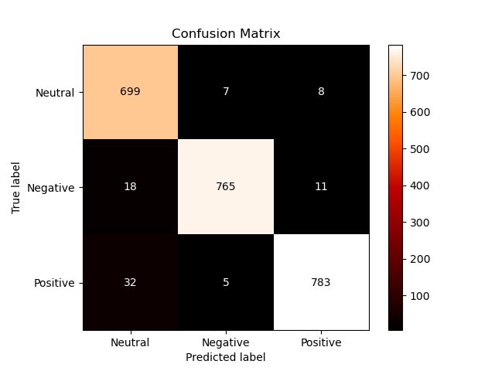


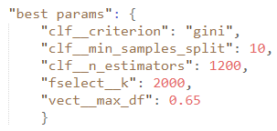
THE TWEETS SENTIMENT CLASSIFIER: BEST MODEL
Comparing the Confusion Matrices of the top 3 classifiers, Random Forest was chosen as best tweet sentiment classifier.
Indeed, it is the classifier that is closer to actual class distribution.
LogReg
Random Forest
SVM
In the end we managed to
reach ~80% of accuracy. Considering the challenging task, the result is not bad.

Slide 25
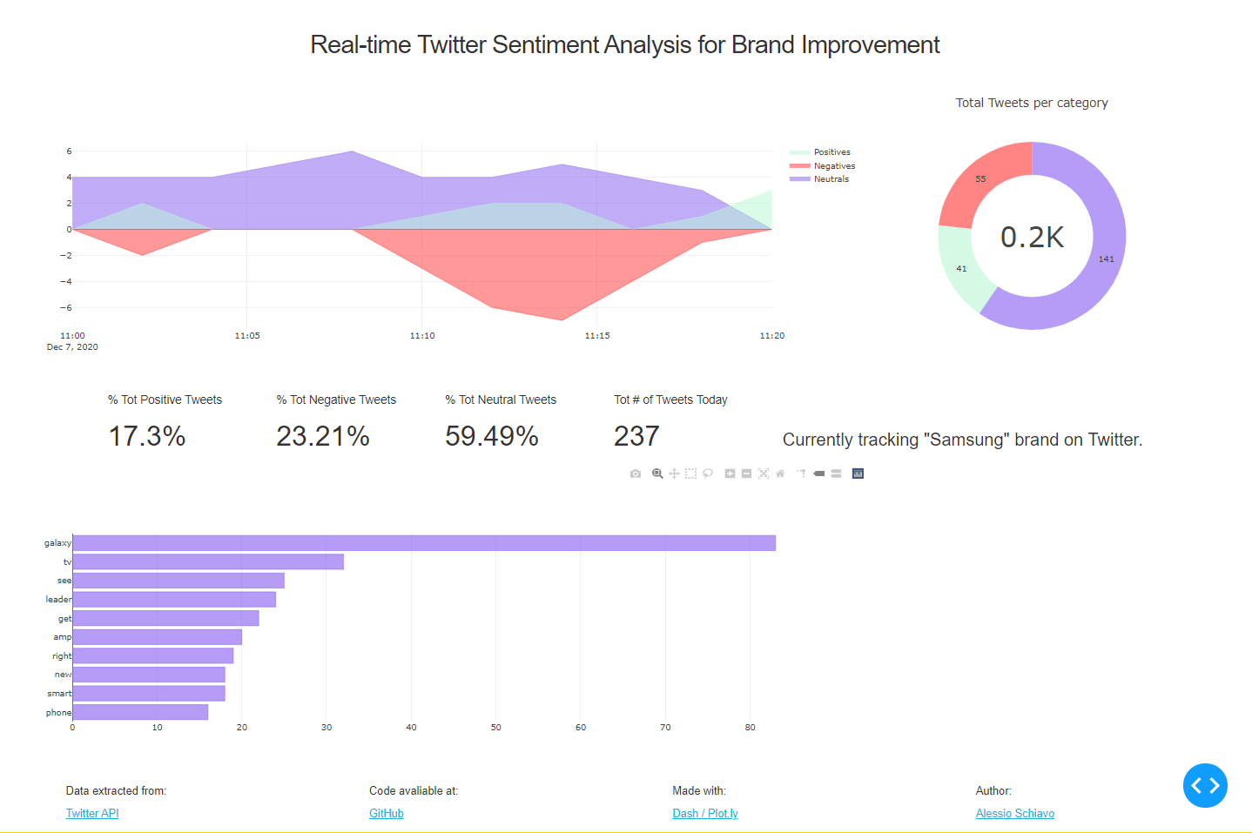

THE WEB DASHBOARD: A SCREENSHOT
The time interval
can be changed!

Slide 26

THANK YOU!

